Slide 1
Marketing Analytics Project
Findings

Slide 2
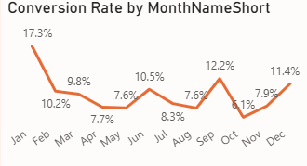
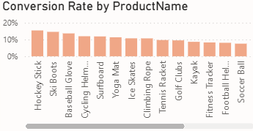
Conversion Rate
Overall conversion rate is 9.6%, with noticeable monthly fluctuations.
Highest conversion rate: January (17.3%) and September (12.2%).
Lowest conversion rate: April (7.6%) and October (7.1%).
Product-wise, Hockey Stick, Ski Boots, Baseball Glove have the highest conversion rates, while Running Shoes and Swim Goggles have the lowest.

Slide 3
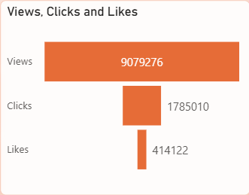
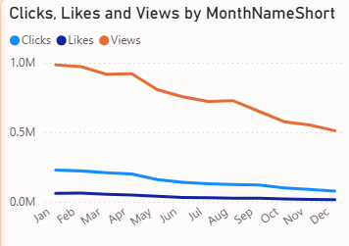
Social Media Engagement
9M total views, 2M clicks, and 414K likes, indicating high visibility but relatively lower engagement beyond views.
Engagement (views, clicks, likes) is declining month-over-month, especially after March.

Slide 4
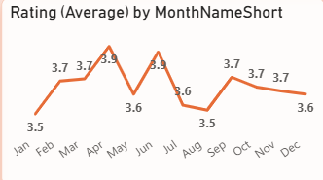
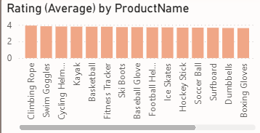
Customer Reviews
Average customer rating stands at 3.7.
Rating trend is mostly stable (3.6–3.9), with April and July peaking.
By product, Climbing Rope, Swim Goggles, Cycling Helmet received higher ratings, while Yoga Mats, Golf Clubs received lower ratings.

Slide 5
Goals & Actions
Goals
Actions
Increase Conversion Rates:
Goal: Identify factors impacting the conversion rate and provide recommendations to improve it.
Insight: Highlight key stages where visitors drop off and suggest improvements to optimize the conversion funnel.
Enhance Customer Engagement:
Goal: Determine which types of content drive the highest engagement.
Insight: Analyze interaction levels with different types of marketing content to inform better content strategies.
Improve Customer Feedback Scores:
Goal: Understand common themes in customer reviews and provide actionable insights.
Insight: Identify recurring positive and negative feedback to guide product and service improvements.
Increase Conversion Rates:
Target High-Performing Product Categories: Focus marketing efforts on products with demonstrated high conversion rates, such as Kayaks, Ski Boots, and Baseball Gloves. Implement seasonal promotions or personalized campaigns during peak months (e.g., January and September) to capitalize on these trends.
Enhance Customer Engagement:
Revitalize Content Strategy: To turn around declining views and low interaction rates, experiment with more engaging content formats, such as interactive videos or user-generated content. Additionally, boost engagement by optimizing call-to-action placement in social media and blog content, particularly during historically lower-engagement months (September-December).
Improve Customer Feedback Scores:
Address Mixed and Negative Feedback: Implement a feedback loop where mixed and negative reviews are analyzed to identify common issues. Develop improvement plans to address these concerns. Consider following up with dissatisfied customers to resolve issues and encourage re-rating, aiming to move average ratings closer to the 4.0 target.

